Slide 1
ECE408 Spring 2018 Applied Parallel Programming Lecture 21: Parallel Sparse Methods

Slide 2
Objective
To learn the key techniques for compacting input data in parallel sparse methods for reduced consumption of memory bandwidth
better utilization of on-chip memory
fewer bytes transferred to on-chip memory
Better utilization of global memory
Challenge: retaining regularity

Slide 3
Sparse Matrix
Many real-world systems are sparse in nature
Linear systems described as sparse matrices
Solving sparse linear systems
Traditional inversion algorithms such as Gaussian elimination can create too many “fill-in” elements and explode the size of the matrix
Iterative Conjugate Gradient solvers based on sparse matrix-vector multiplication is preferred
Solution of PDE systems can be formulated into linear operations expressed as sparse matrix-vector multiplication

Slide 4
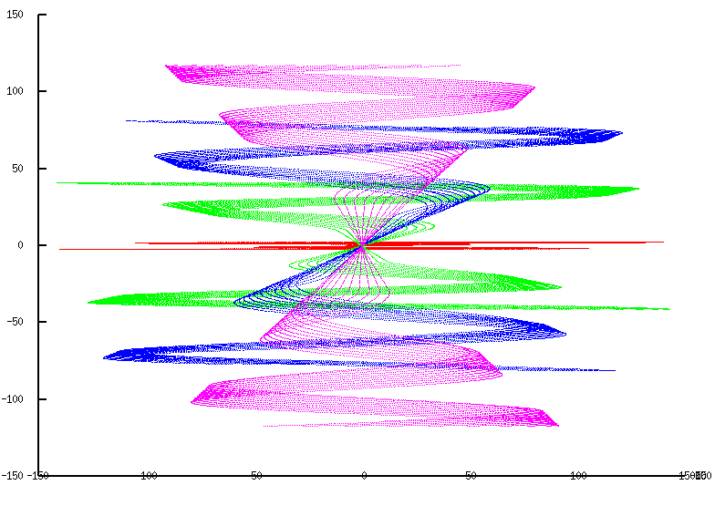
Sparse Data Motivation for Compaction
Many real-world inputs are sparse/non-uniform
Signal samples, mesh models, transportation networks, communication networks, etc.

Slide 5
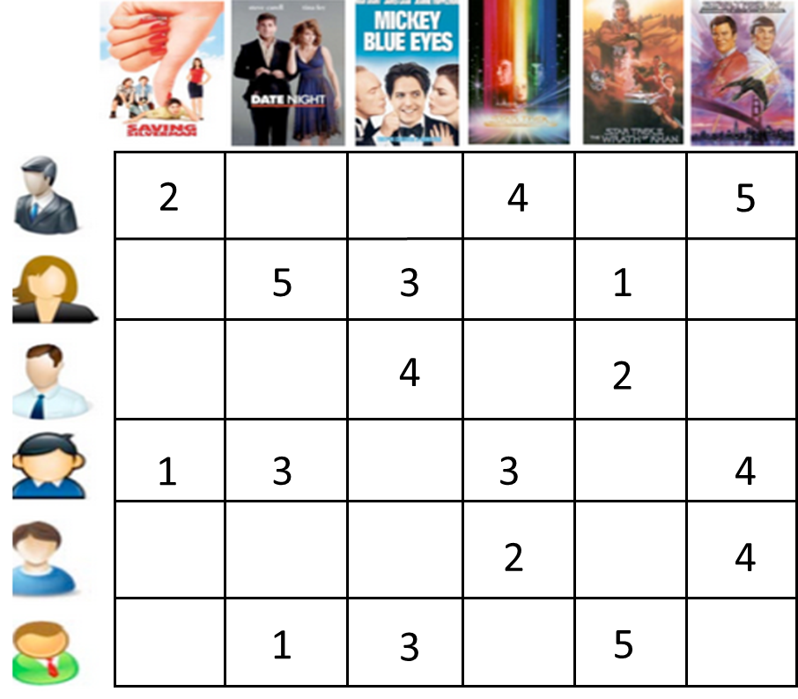





Sparse Matrix in Analytics and AI
Predict missing ratings
Group similar users/items
Recommender systems
Natural language processing
Matrix
Factorization
Latent semantic model
Word embedding as input to DNN
Complex network
Deep learning
Link prediction
Vertices clustering
Model compression
Embedding layer
Web search
Tensor decomposition
Match query and document
In machine learning and HPC applications
R

Slide 6
Science Area | Number of Teams | Codes | Struct Grids | Unstruct Grids | Dense Matrix | Sparse Matrix | N-Body | Monte Carlo | FFT | PIC | Sig I/O
Climate and Weather | 3 | CESM, GCRM, CM1/WRF, HOMME | X | X |  | X |  | X |  |  | X
Plasmas/ Magnetosphere | 2 | H3D(M),VPIC, OSIRIS, Magtail/UPIC | X |  |  |  | X |  | X |  | X
Stellar Atmospheres and Supernovae | 5 | PPM, MAESTRO, CASTRO, SEDONA, ChaNGa, MS-FLUKSS | X |  |  | X | X | X |  | X | X
Cosmology | 2 | Enzo, pGADGET | X |  |  | X | X
Combustion/ Turbulence | 2 | PSDNS, DISTUF | X |  |  |  |  |  | X
General Relativity | 2 | Cactus, Harm3D, LazEV | X |  |  | X
Molecular Dynamics | 4 | AMBER, Gromacs, NAMD, LAMMPS |  |  |  | X | X |  | X
Quantum Chemistry | 2 | SIAL, GAMESS, NWChem |  |  | X | X | X | X |  |  | X
Material Science | 3 | NEMOS, OMEN, GW, QMCPACK |  |  | X | X | X | X
Earthquakes/ Seismology | 2 | AWP-ODC, HERCULES, PLSQR, SPECFEM3D | X | X |  |  | X |  |  |  | X
Quantum Chromo Dynamics | 1 | Chroma, MILC, USQCD | X |  | X | X
Social Networks | 1 | EPISIMDEMICS
Evolution | 1 | Eve
Engineering/System of Systems | 1 | GRIPS,Revisit |  |  |  |  |  | X
Computer Science | 1 |  |  | X | X | X |  |  | X |  | X

Slide 7
Sparse Matrix-Vector Multiplication (SpMV)
×
+
A
X
Y
Y

Slide 8
Challenges
Compared to dense matrix multiplication, SpMV
Is irregular/unstructured
Has little input data reuse
Benefits little from compiler transformation tools
Key to maximal performance
Maximize regularity (by reducing divergence and load imbalance)
Maximize DRAM burst utilization (layout arrangement)

Slide 9
A Simple Parallel SpMV
Row 0 | 3 | 0 | 1 | 0 | Thread 0
Row 1 | 0 | 0 | 0 | 0 | Thread 1
Row 2 | 0 | 2 | 4 | 1 | Thread 2
Row 3 | 1 | 0 | 0 | 1 | Thread 3
Each thread processes one row

Slide 10
Compressed Sparse Row (CSR) Format
CSR Representation
 |  |  | Row 0 |  |  | Row 2 |  |  |  | Row 3
Nonzero values | data[7] | { | 3, | 1, |  | 2, | 4, | 1, |  | 1, | 1 | }
Column indices | col_index[7] | { | 0, | 2, |  | 1, | 2, | 3, |  | 0, | 3 | }
Row Pointers | ptr[5] | { | 0, 2, 2, 5, 7 }
Dense representation
Row 0 | 3 | 0 | 1 | 0 | Thread 0
Row 1 | 0 | 0 | 0 | 0 | Thread 1
Row 2 | 0 | 2 | 4 | 1 | Thread 2
Row 3 | 1 | 0 | 0 | 1 | Thread 3

Slide 11
CSR Data Layout
row_ptr
0
2
2
5
7
data
3
1
2
4
1
1
1
col_index
0
2
1
2
3
0
3

Slide 12
CSR Kernel Design
Dot product
With vector
ptr
CSR Format

Slide 13
A Parallel SpMV/CSR Kernel (CUDA)
__global__ void SpMV_CSR(int num_rows, float *data,
int *col_index, int *row_ptr, float *x, float *y) {
2. int row = blockIdx.x * blockDim.x + threadIdx.x;
3. if (row < num_rows) {
4. float dot = 0;
5. int row_start = row_ptr[row];
6. int row_end = row_ptr[row+1];
7. for (int elem = row_start; elem < row_end; elem++) {
8. dot += data[elem] * x[col_index[elem]];
}
9. y[row] = dot;
}
}
 |  |  | Row 0 |  |  | Row 2 |  |  |  | Row 3
Nonzero values | data[7] | { | 3, | 1, |  | 2, | 4, | 1, |  | 1, | 1 | }
Column indices | col_index[7] | { | 0, | 2, |  | 1, | 2, | 3, |  | 0, | 3 | }
Row Pointers | row_ptr[5] | { | 0, 2, 2, 5, 7 }

Slide 14
CSR Kernel Control Divergence
Threads execute different number of iterations in the kernel for-loop
row_ptr
0
2
2
5
7
data
3
1
2
4
1
1
1
col_index
0
2
1
2
3
0
3

Slide 15
CSR Kernel Memory Divergence (Uncoalesced Accesses)
Adjacent threads access non-adjacent memory locations
Grey elements are accessed by all threads in iteration 0
row_ptr
0
2
2
5
7
data
3
1
2
4
1
1
1
col_index
0
2
1
2
3
0
3

Slide 16
Regularizing SpMV with ELL(PACK) Format
3
1
*
Thread 0
Thread 1
Thread 2
Thread 3
*
*
*
3
*
2
1
2
4
1
1
*
4
1
1
1
*
*
*
1
*
CSR with Padding
Transposed
Pad all rows to the same length
Inefficient if a few rows are much longer than others
Transpose (Column Major) for DRAM efficiency
Both data and col_index padded/transposed

Slide 17
ELL Kernel Design
3
*
2
1
1
*
4
1
*
*
1
*
A
ELL Format

Slide 18
A parallel SpMV/ELL kernel
__global__ void SpMV_ELL(int num_rows, float *data,
int *col_index, int num_elem, float *x, float *y) {
2. int row = blockIdx.x * blockDim.x + threadIdx.x;
3. if (row < num_rows) {
4. float dot = 0;
5. for (int i = 0; i < num_elem; i++) {
6. dot += data[row+i*num_rows]*x[col_index[row+i*num_rows]];
}
7. y[row] = dot;
}
}

Slide 19
Memory Coalescing with ELL
3
*
2
1
Thread 0
1
*
4
1
Thread 1
Thread 2
Thread 3
*
*
1
*
data
3
*
2
1
1
*
4
1
*
*
1
*
0
0
1
0
2
1
2
3
3
2
3
1
col_index

Slide 20
Coordinate (COO) format
Explicitly list the column and row indices for every non-zero element
 |  |  | Row 0 |  |  | Row 2 |  |  |  | Row 3
Nonzero values | data[7] | { | 3, | 1, |  | 2, | 4, | 1, |  | 1, | 1 | }
Column indices | col_index[7] | { | 0, | 2, |  | 1, | 2, | 3, |  | 0, | 3 | }
Row indices | row_index[7] | { | 0, | 0, |  | 2, | 2, | 2, |  | 3, | 3 | }

Slide 21
COO Allows Reordering of Elements
 |  |  | Row 0 |  |  | Row 2 |  |  |  | Row 3
Nonzero values | data[7] | { | 3, | 1, |  | 2, | 4, | 1, |  | 1, | 1 | }
Column indices | col_index[7] | { | 0, | 2, |  | 1, | 2, | 3, |  | 0, | 3 | }
Row indices | row_index[7] | { | 0, | 0, |  | 2, | 2, | 2, |  | 3, | 3 | }
Nonzero values | data[7] | { | 1 | 1, | 2, | 4, | 3, | 1 | 1 | }
Column indices | col_index[7] | { | 0 | 2, | 1, | 2, | 0, | 3, | 3 | }
Row indices | row_index[7] | { | 3 | 0, | 2, | 2, | 0, | 2, | 3 | }

Slide 22
1. for (int i = 0; i < num_elem; row++)
2. y[row_index[i]] += data[i] * x[col_index[i]];
a sequential loop that implements SpMV/COO

Slide 23
Read Chapter 10

